Slide 1

Information Assurance
CIA Example: Ashley Madison

Slide 2
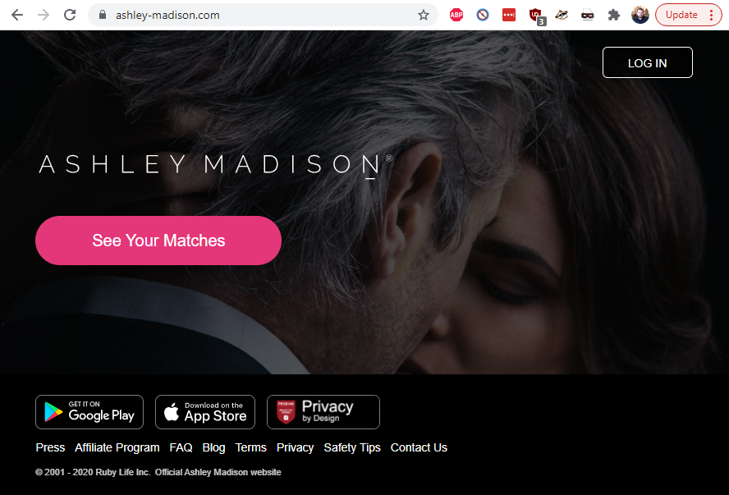

Slide 3
Ashley Madison
Ashley Madison is an online dating service and social networking service marketed to people who are married or in relationships. It was founded in 2002 with the slogan: "Life is short. Have an affair.“
The company received attention on July 15, 2015, after a data breach was publicized. They were said to have lost everything - including email addresses, names, home addresses, sexual fantasies and credit card information

Slide 4
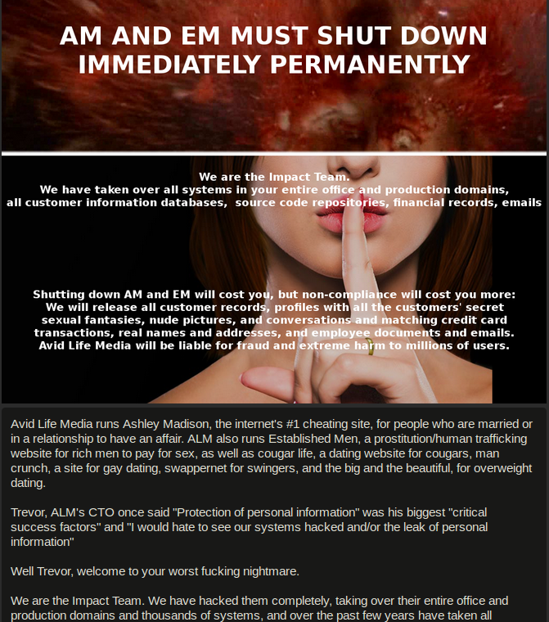
Ashley Madison
July 12, 2015: Avid Life Media (Ashley Madison's parent firm) employees log in to find a message from Impact Team threatening to release company and customer data unless the Ashley Madison and Established Men websites are shut down. Impact Team's ransom message is accompanied by the AC/DC song "Thunderstruck.“

Slide 5
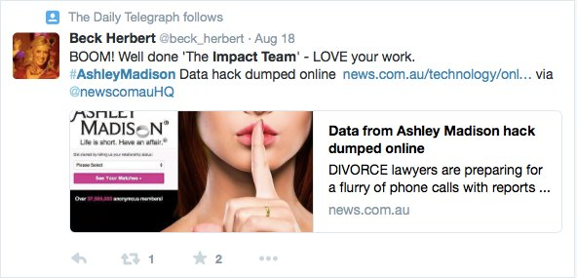
Ashley Madison
This move was celebrated by some.
July 19, 2015: Impact Team publishes their warning message on Pastebin, this time setting a 30-day window for Avid Life Media to shut down the sites before the information is released.

Slide 6
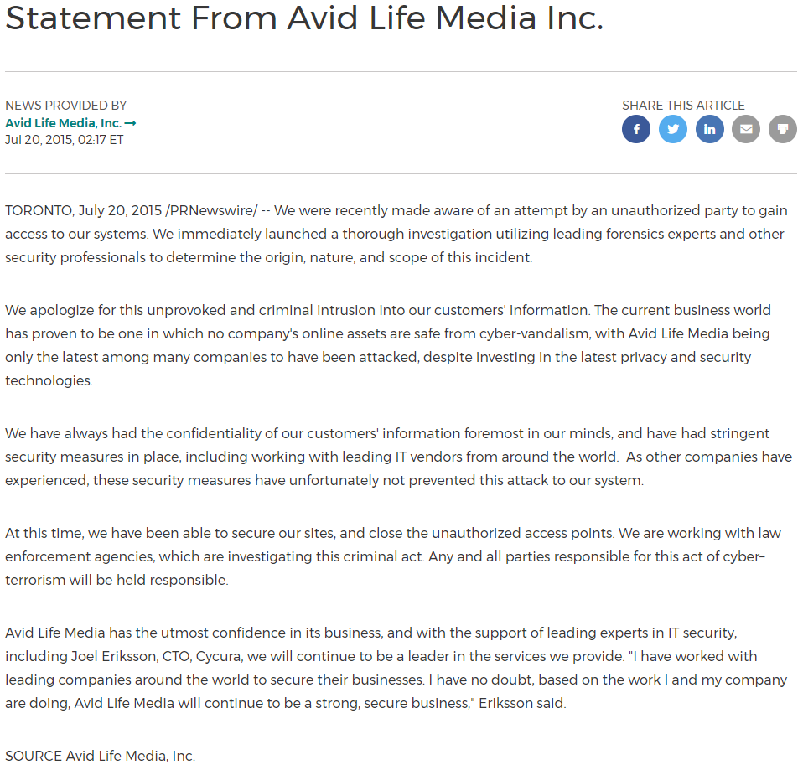
Ashley Madison
July 20, 2015: Avid Life Media issues two statements acknowledging “an attempt by an unauthorized party to gain access to our systems” and announcing a joint investigation conducted by Ashley Madison, law enforcement, and the cybersecurity service provider Cycura.

Slide 7
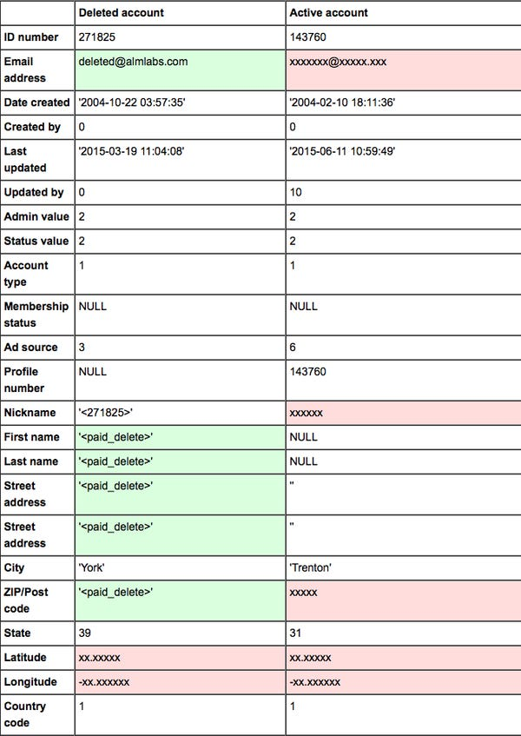
Ashley Madison
July 22, 2015: Impact Team releases the names and information of two Ashley Madison users - a man from Brockton, MA and a man from Ontario, Canada - in the first data leak to come from the hack.

Slide 8
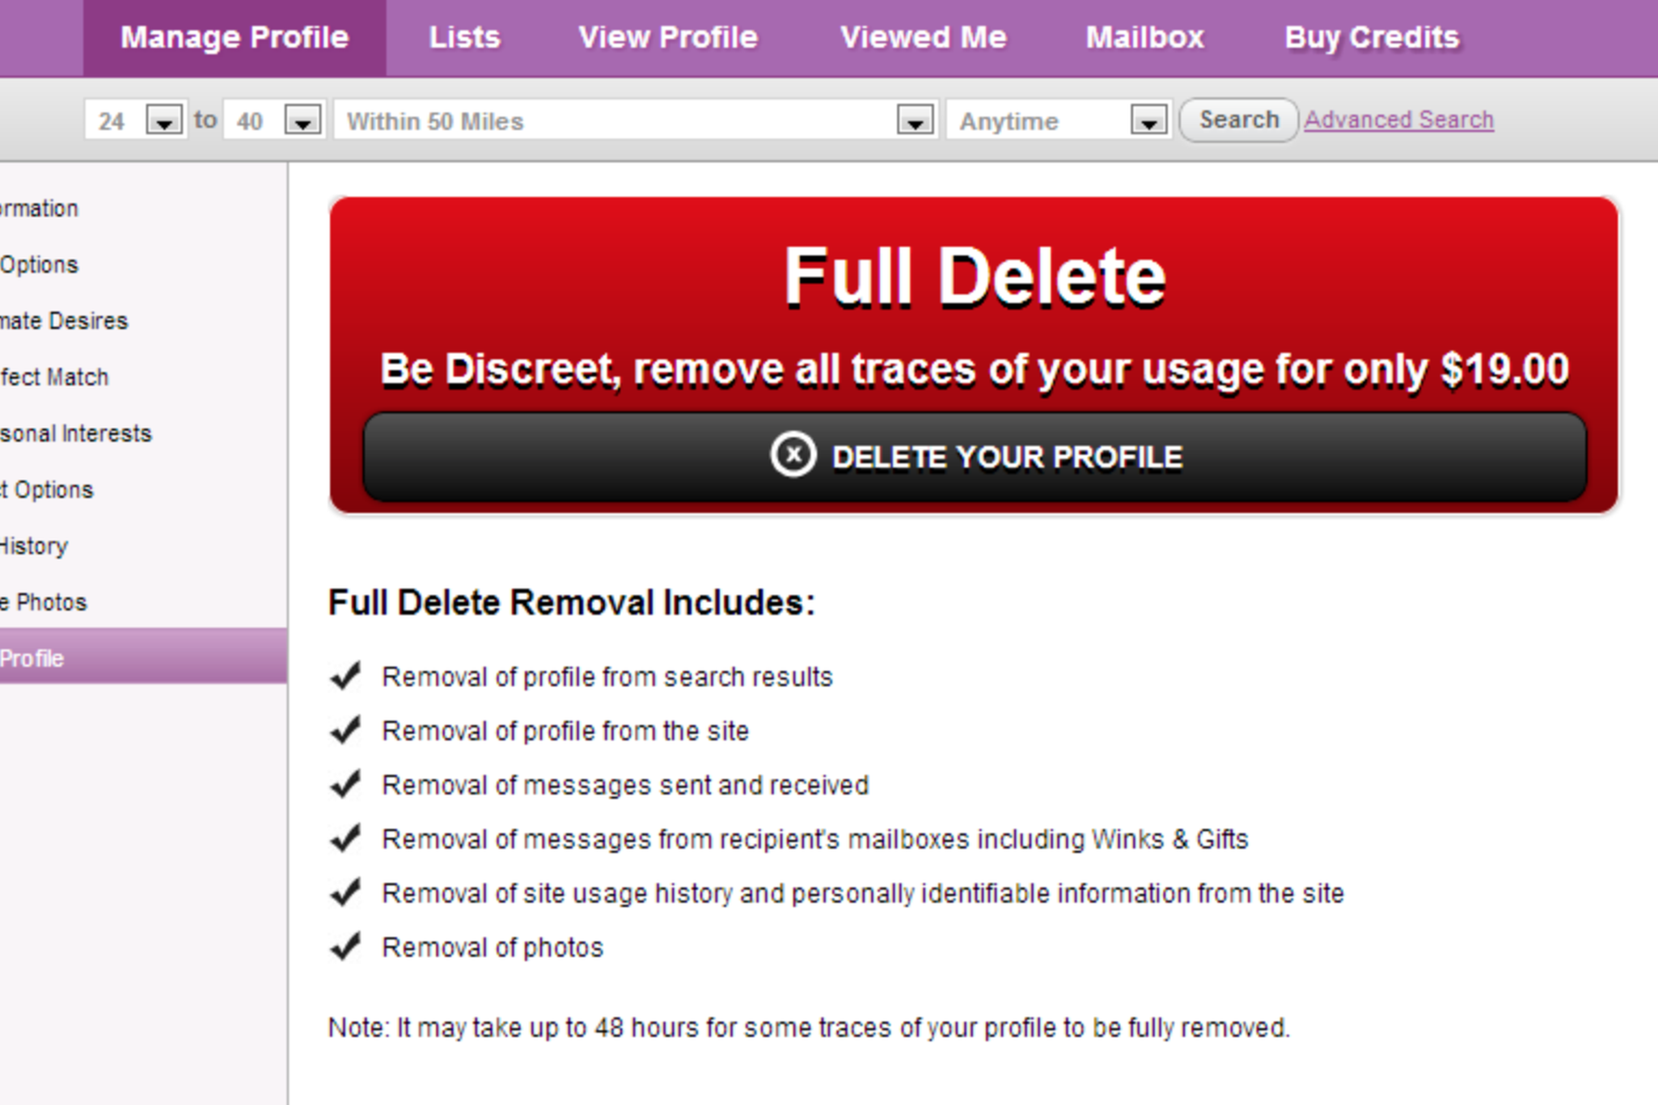
Ashley Madison
The release included data from customers who had previously paid a $19 fee to Ashley Madison to supposedly have their data deleted.
The fee was also applied to people who had accounts set up against their will, as a workplace prank, or because of a mistyped email address.

Slide 9
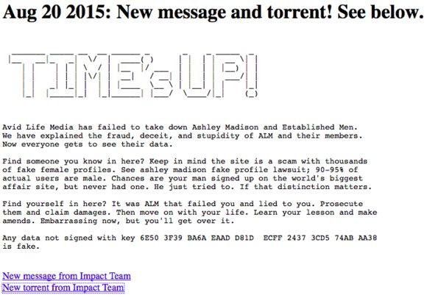
Ashley Madison
August 18, 2015: Impact Team's 30 day window expires, but Ashley Madison and Established Men are still online. In a Pastebin post titled "TIME'S UP," Impact Team publishes the first major Ashley Madison user data dump, a torrent file containing nearly 10gb.

Slide 10
Ashley Madison
August 18, 2015: Following the first data dump, Avid Life Media combats proliferation of the news story by issuing takedown requests. They issue another statement on the hack detailing their investigation and asking for information on the incident.

Slide 11
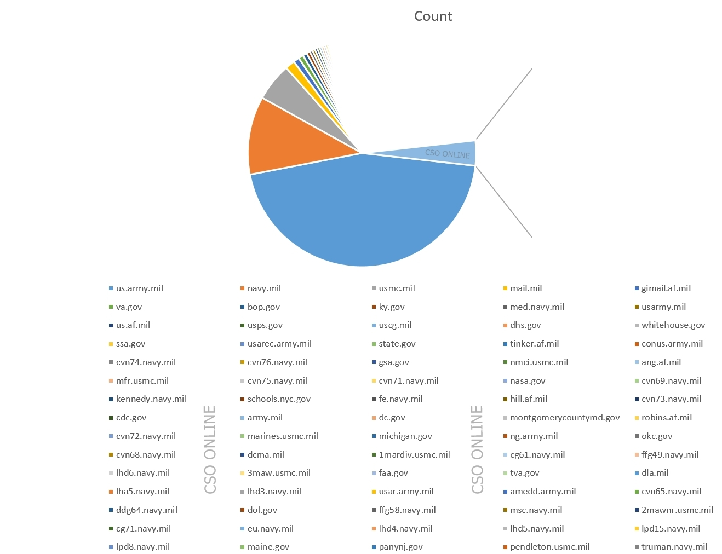
Ashley Madison
August 18, 2015: A categorical breakdown of the email addresses disclosed in the first data dump is posted to Pastebin.

Slide 12
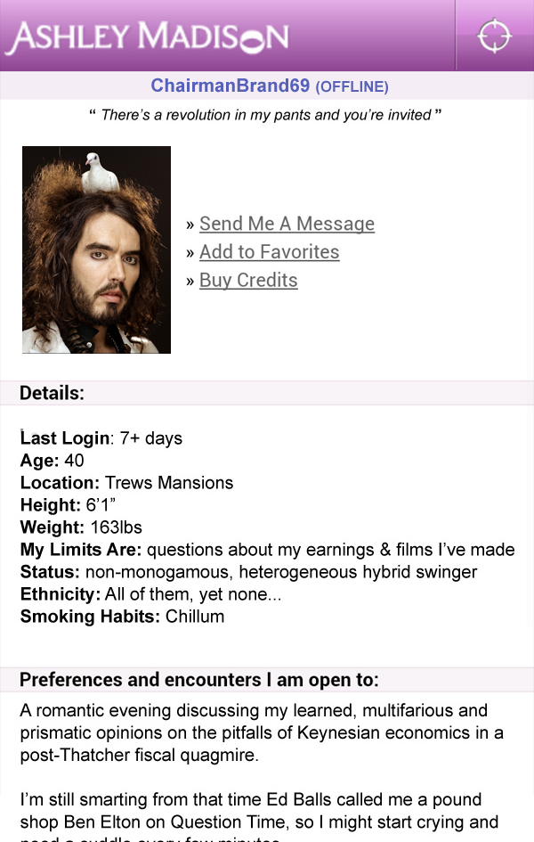
Ashley Madison
August 18-19, 2015: After a nearly day-long media frenzy met with much speculation over the validity of the leaked data, Brian Krebs discloses that numerous Ashley Madison account holders have confirmed that their information was published.

Slide 13
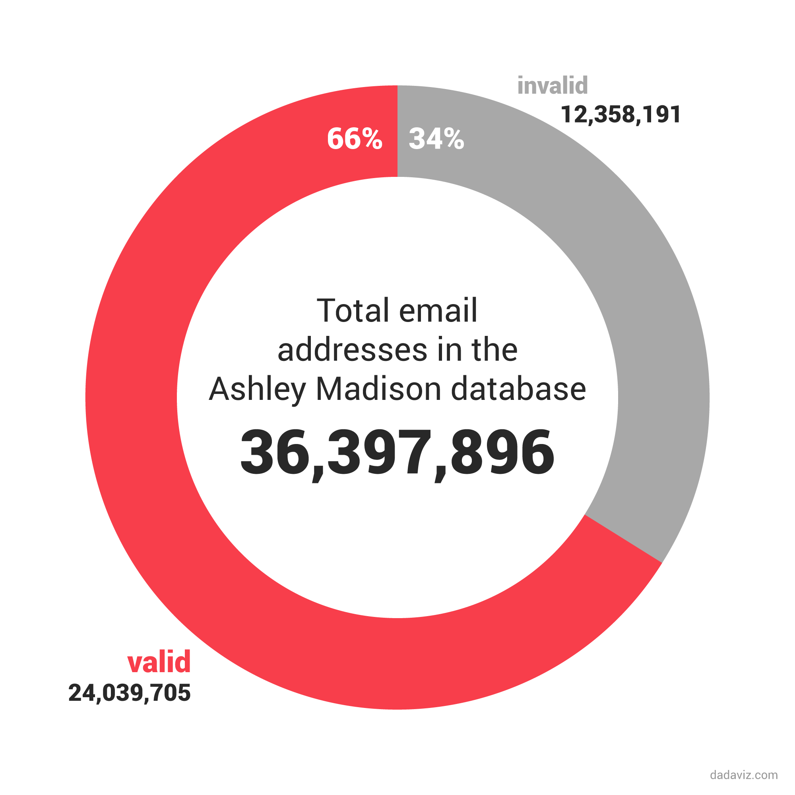
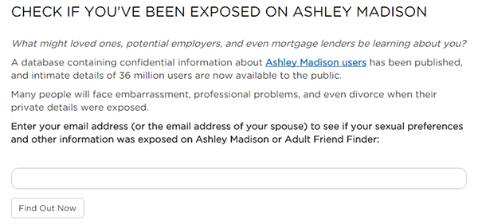
Ashley Madison
August 19-20, 2015: As researchers continue to sift through the first data dump, search websites pop up that let users search to see if their email addresses were leaked.

Slide 14
Ashley Madison
August 20, 2015: Impact Team leaks a second major dump of Ashley Madison data. Unlike the first, which was primarily user data, this dump contains nearly 20 gigabytes of mostly internal data, including Avid Life Media CEO Noel Biderman's emails and Ashley Madison website source code.
August 21, 2015: The Impact Team does an interview with a freelance journalist forking for Vice (Motherboard).
August 23, 2015: The Ashley Madison data dumps continue with a third round of Pastebin leaks. Leaked data includes a full list of government emails used for accounts (sorted by department) as well as lists of Ashley Madison users in Mississippi, Louisiana, and Alabama.

Slide 15
Ashley Madison
August 24, 2015: Two Canadian law firms announce a joint $578 million class action lawsuit against Ashley Madison.
August 24, 2015: In the most tragic news to come out of the Ashley Madison hack, Toronto police report two suicides following dumps of user data. Following the announcement from the Toronto police, Ashley Madison offers a $500,000 bounty for information on Impact Team or the attack.

Slide 16
Ashley Madison
August 24, 2015: After analyzing many of Noel Biderman's emails that were leaked in the second data dump, there is evidence that Ashley Madison founding CTO Raja Bhatia had hacked competing dating site nerve.com in 2012.
The leaked emails also included messages from Ashley Madison director of security Mark Steele warning Biderman of multiple cross-site scripting and cross-site request forgery vulnerabilities in their codebase. Steele's emails were as recent as May 25, 2015.

Slide 17
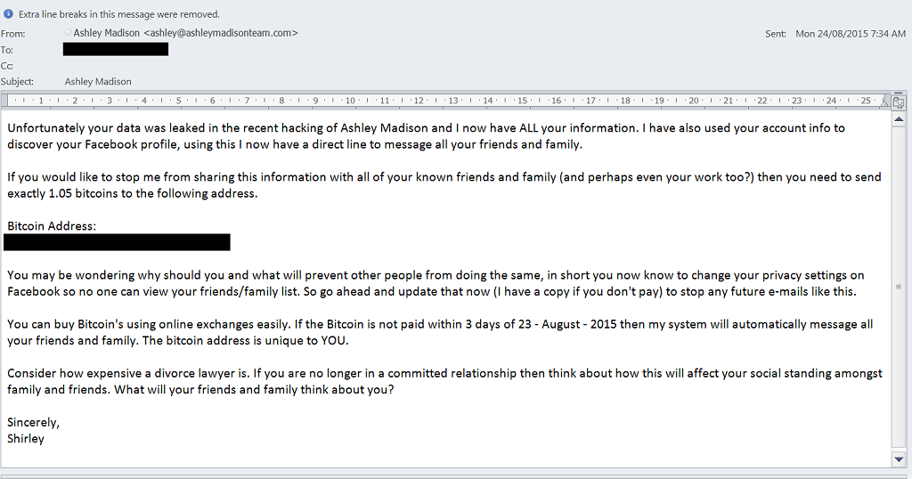
Ashley Madison
August 25-26, 2015: The data dumps continue with state-by-state leaks of personal data of Ashley Madison users from New Jersey, New York, California, Georgia, and Arkansas appearing on Pastebin.
August 27, 2015: Just over a week after the first major data dump, reports of blackmail and identity theft targeting leaked Ashley Madison users surface

Slide 18
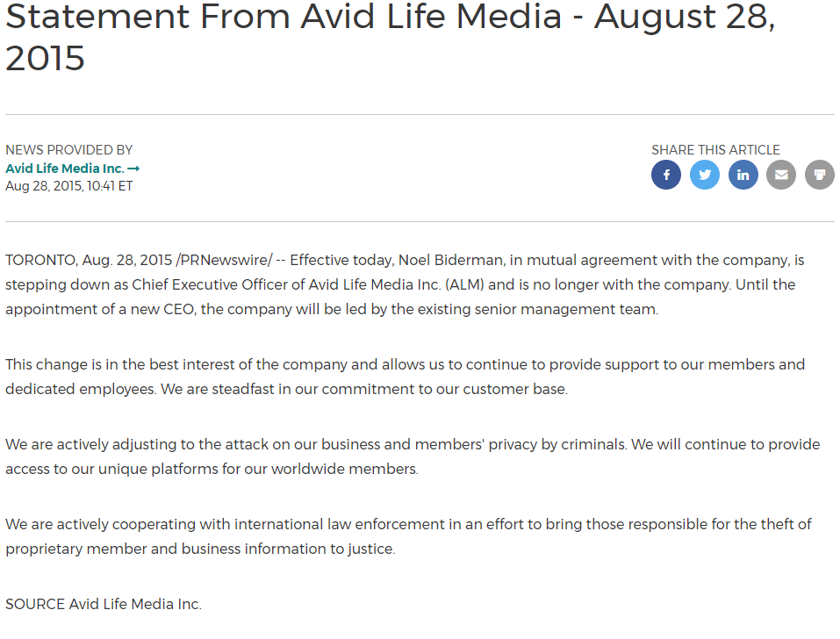

Slide 19
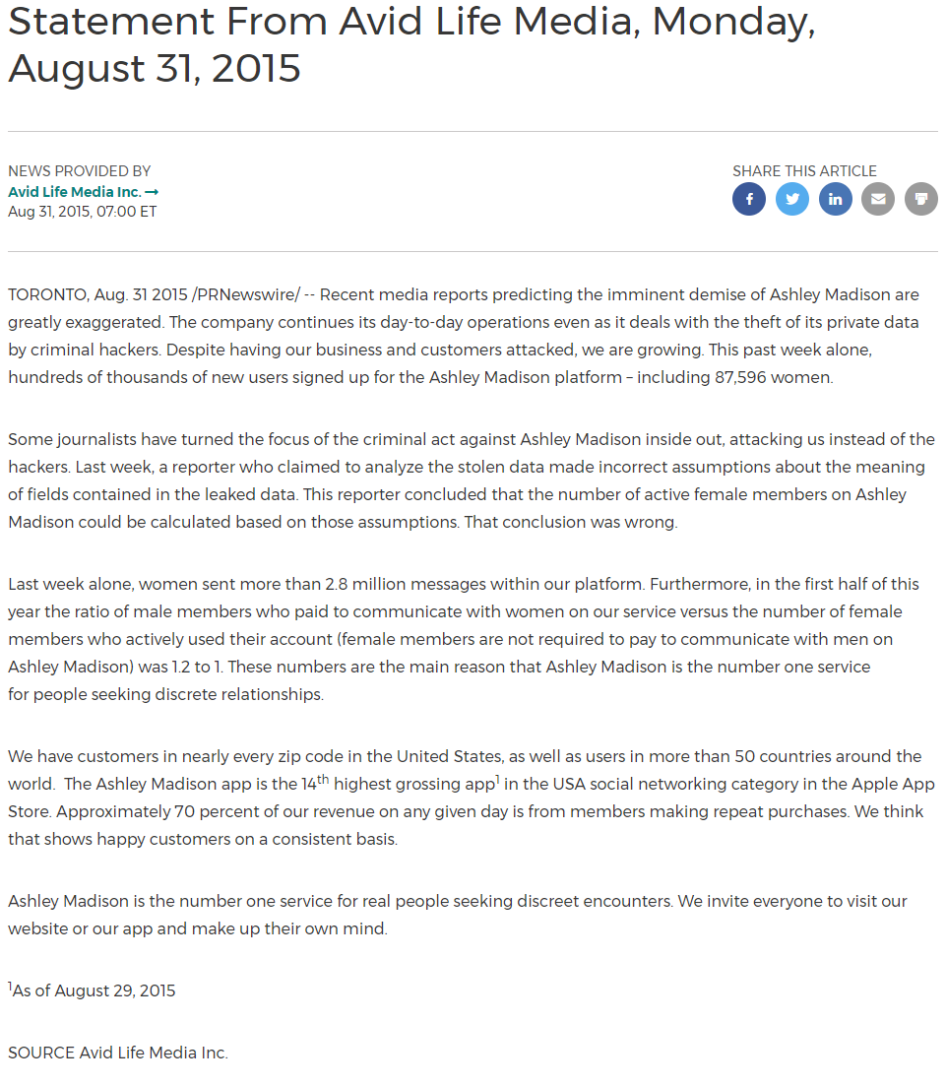

Slide 21
Ashley Madison
September 9, 2015: Security researcher Gabor Szathmari announces that he has discovered poor security practices in Ashley Madison source code:
Hardcoded security credentials including “database passwords, API secrets, authentication tokens and SSL private keys."
No form or email validation to help screen out bots (or prank/malicious accounts.)

Slide 22
Ashley Madison
September 10, 2015: A blog post from a cracking group called CynoSure Prime exposes that Ashley Madison failed to use a robust encryption strategy for its user passwords, allowing the group to crack over 11MM passwords in just 10 days.
The group published an analysis of the top passwords used by Ashley Madison members, who also exhibited poor password security.

Slide 23
Mark of the week: Ashley Madison
PASSWORD | NUMBER OF USERS
123456 | 120511
12345 | 48452
password | 39448
DEFAULT | 34275
123456789 | 26620
qwerty | 20778
12345678 | 14172
abc123 | 10869
pussy | 10683
1234567 | 9468
696969 | 8801
ashley | 8793
fuckme | 7893
football | 7872
baseball | 7710
fuckyou | 7458
111111 | 7048
1234567890 | 6572
ashleymadison | 6213
password1 | 5959
madison | 5219
asshole | 5052
superman | 5023
mustang | 4865
harley | 4815
654321 | 4729
123123 | 4612
hello | 4425
shadow | 3831
michael | 3743
121212 | 3713
666666 | 3704
iloveyou | 3671
qwertyuiop | 3599
secret | 3522
buster | 3402
horny | 3389
jordan | 3368
hosts | 3295
zxcvbnm | 3280
asdfghjkl | 3174
affair | 3156
dragon | 3152
987654 | 3123
liverpool | 3087
bigdick | 3058
monkey | 4296
000000 | 4240
hockey | 4191
letmein | 4140
11111 | 4077
soccer | 3936
cheater | 3908
kazuga | 3871
hunter | 3869

